Slide 1
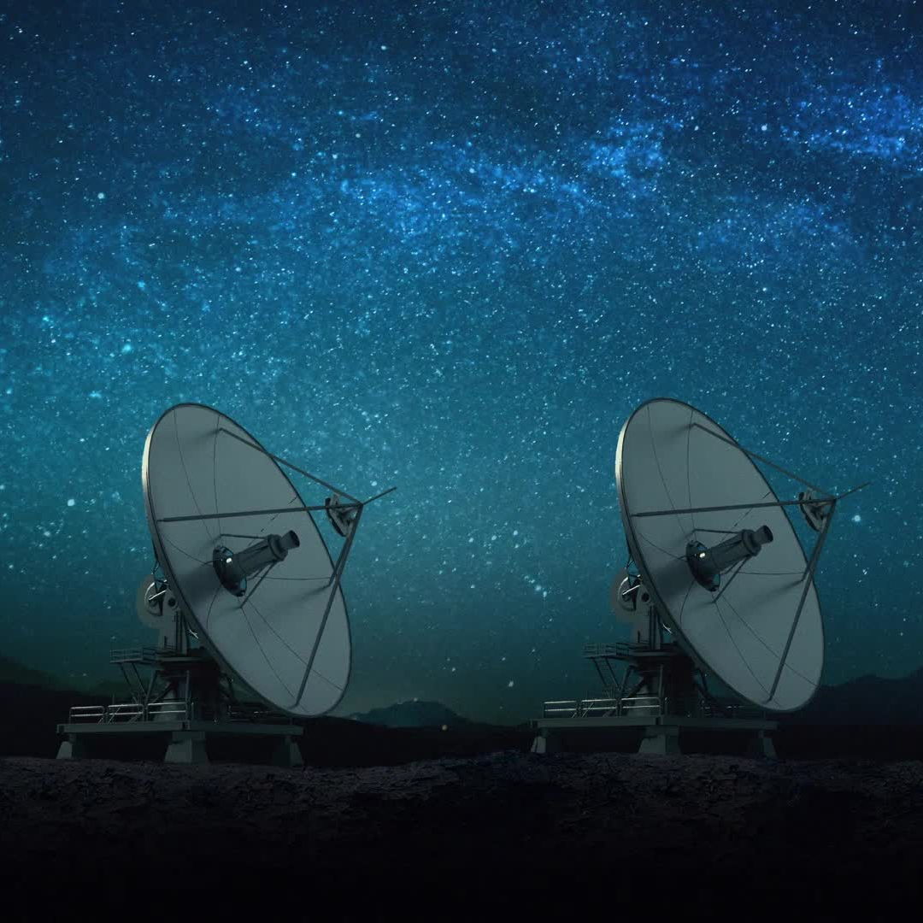
Mars Len
An iOS app of exploring NASA's Mars missions.

Slide 2
Overview
Proposal – Milestone1
Prototype – Milestone2
Features – Milestone3
Authentication
Realtime Database
Retrieve Data from API
Version Comparison
Challenges
Upload App Store – Milestone4
Conclusion

Slide 3
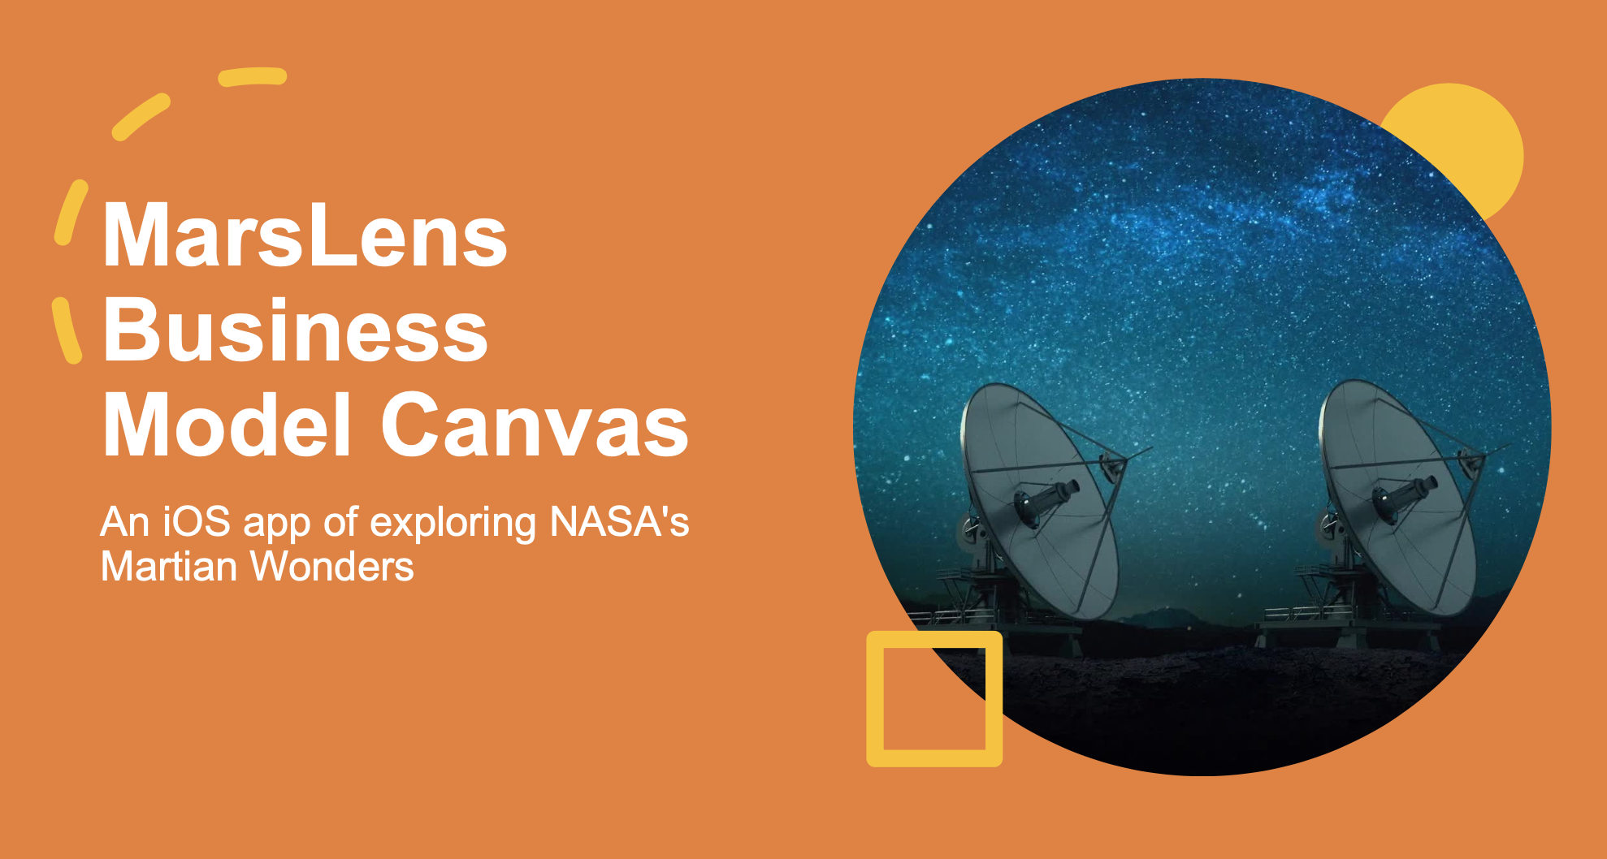
Proposal – Milestone1
Customer Segments
Value Propositions
Channels
Customer Relationships
Revenue Streams
Key Resources
Key Partnerships

Slide 4
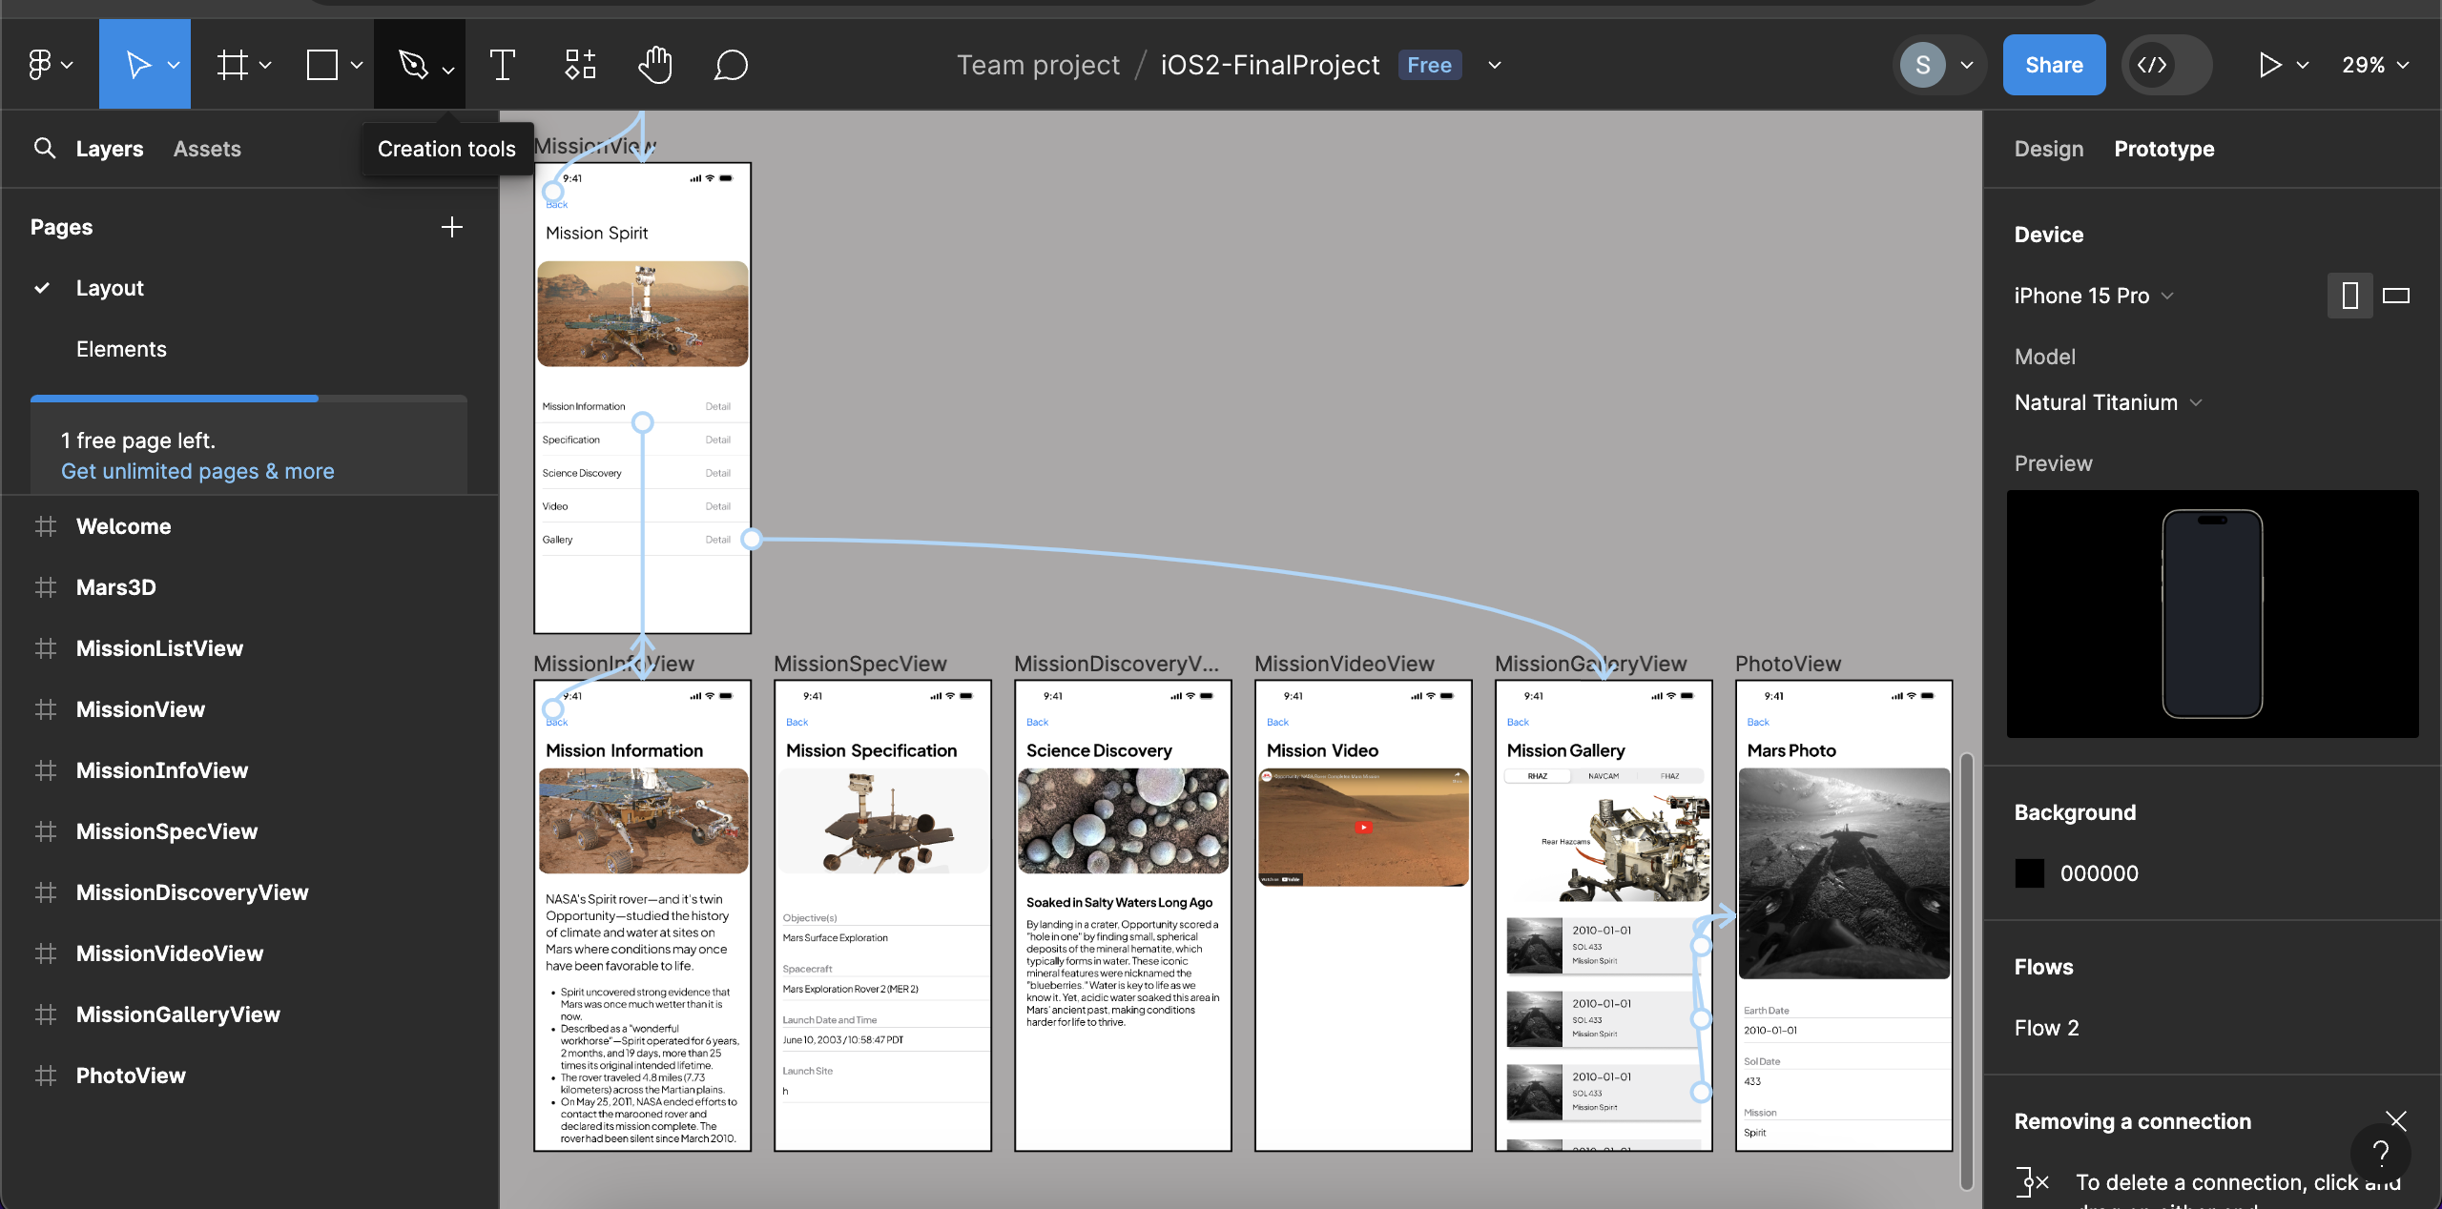
Prototype – Milestone2
Design and prototype using Figma

Slide 5
Upload App Store – Milestone4

Slide 6
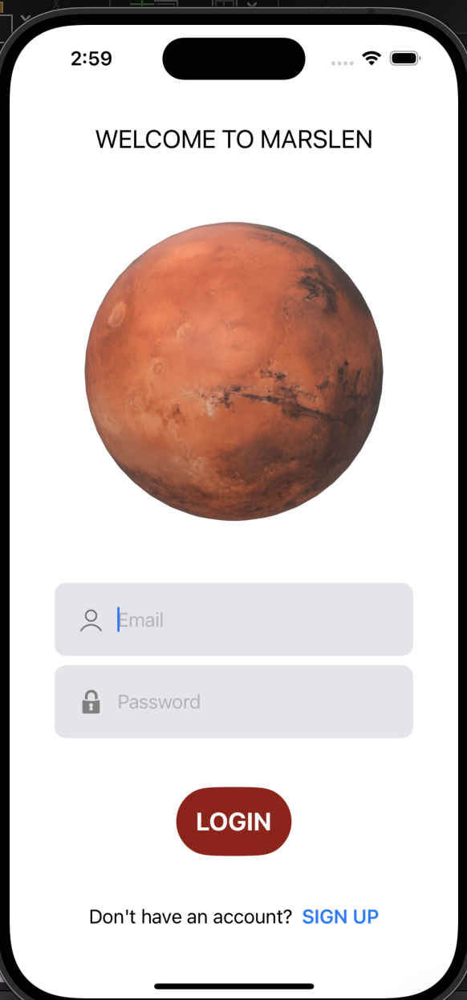
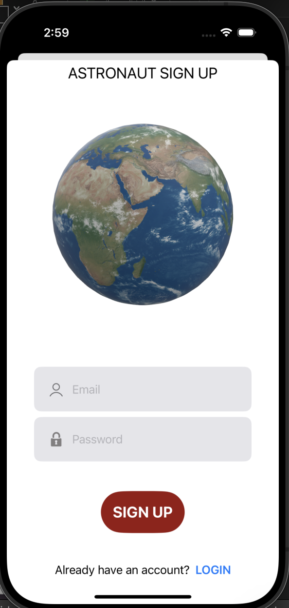
Features – Milestone3
Sign up & Log in
Firebase Authentication

Slide 7
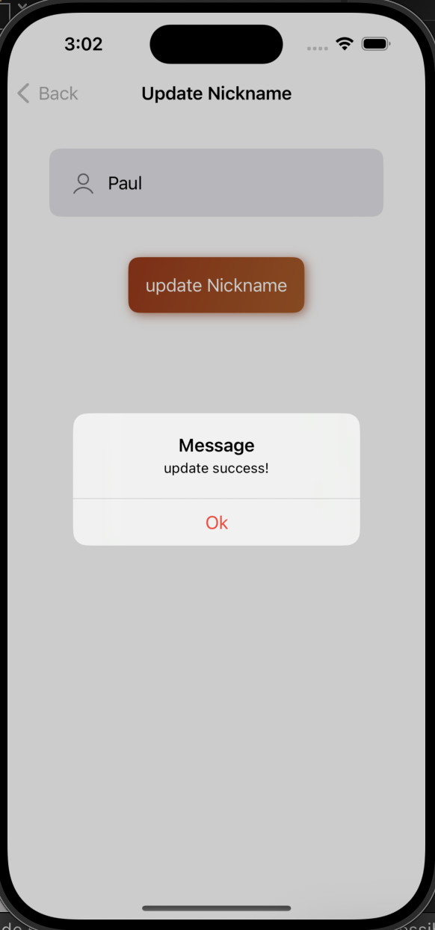
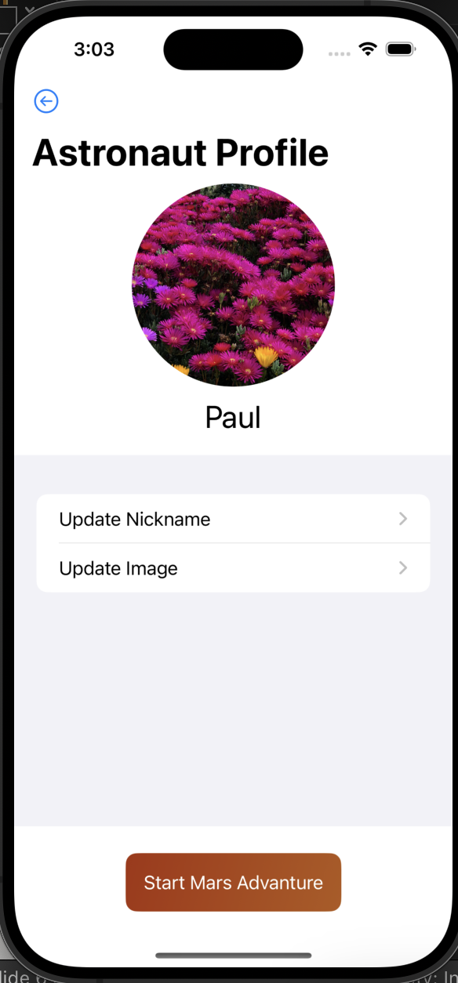
Features – Milestone3
Load & Update nickname
Firebase Real-time Database
Upload image
Firebase Storage

Slide 8
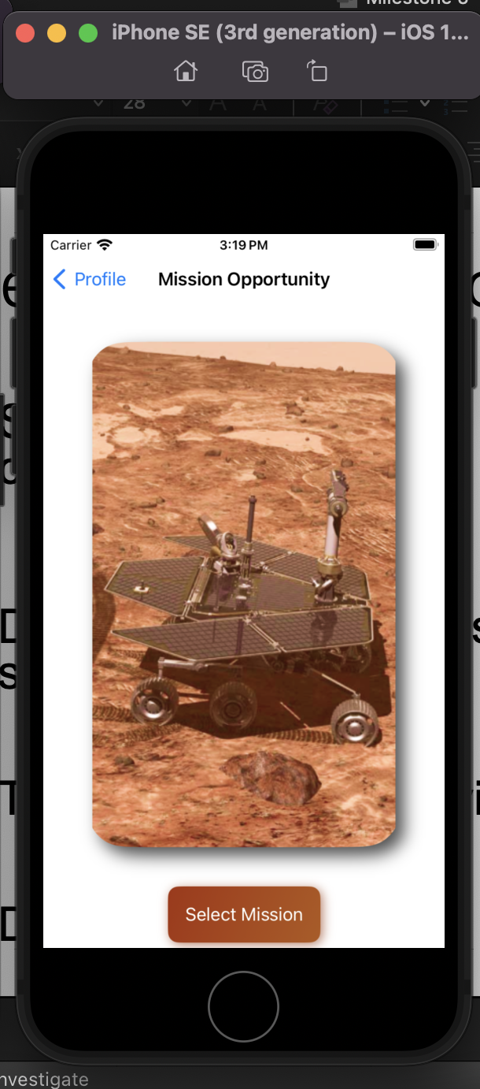
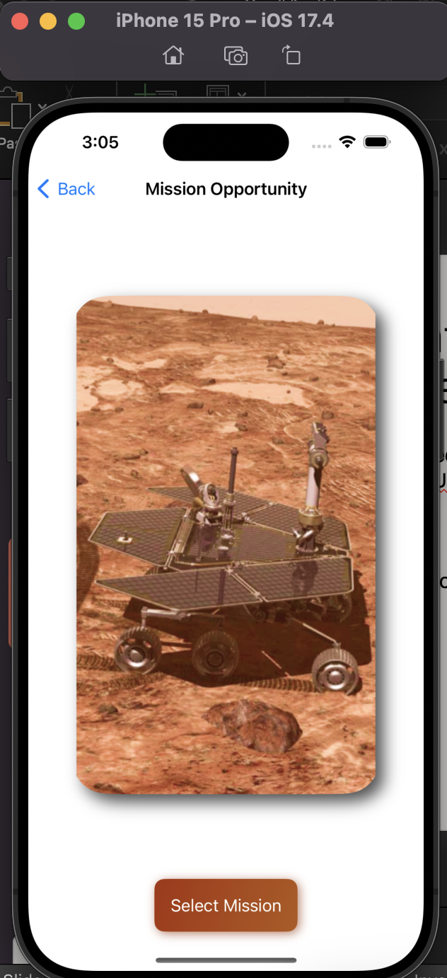
Features – Milestone3
Tested on multiple devices
UIScreen.main.bounds.size.width
Demo

Slide 9
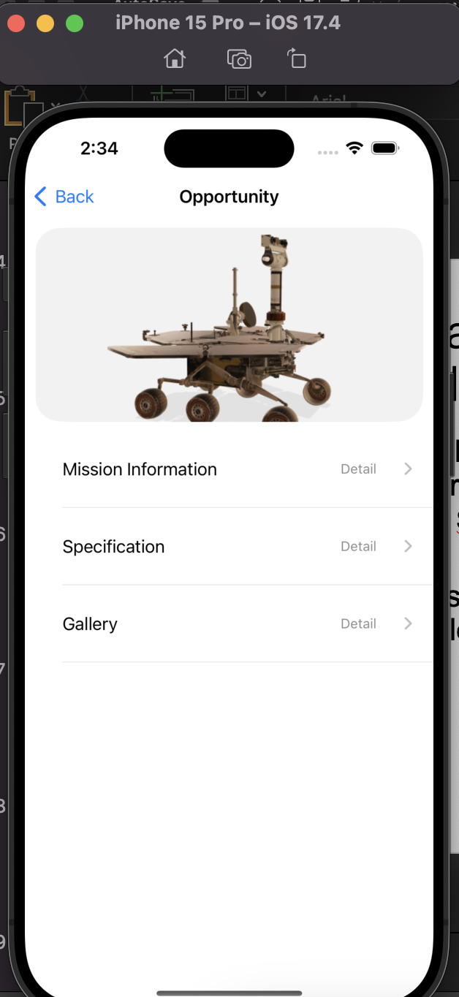
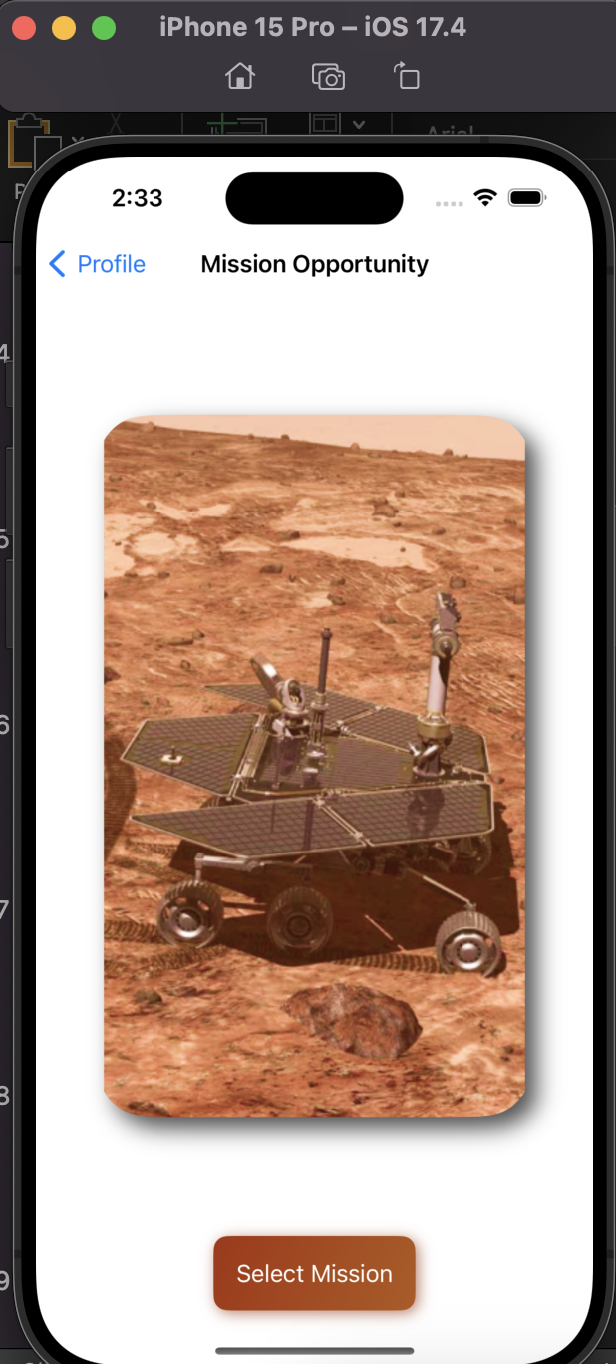
Features – Milestone3
Select Mission with an image carousel
SwiftUI - DragGesture
Display information based on selection
Demo

Slide 10
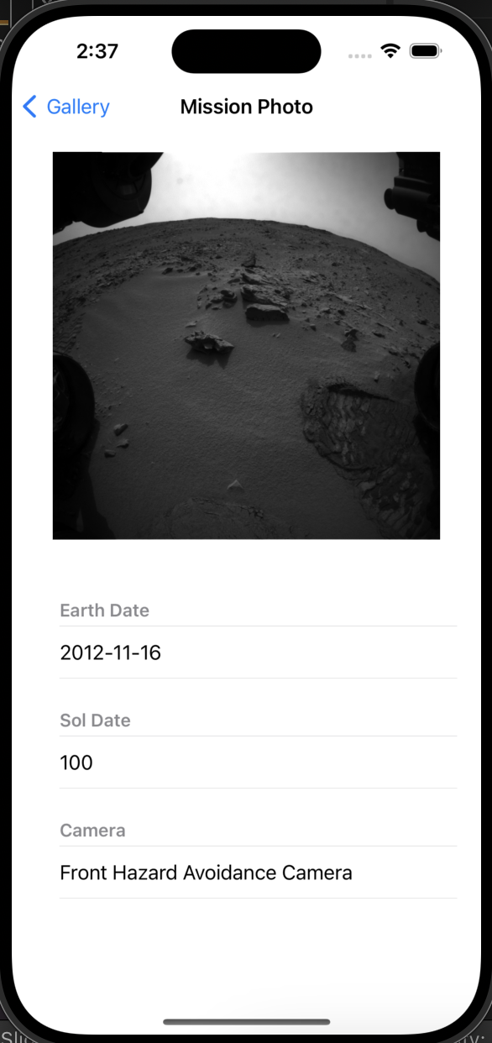
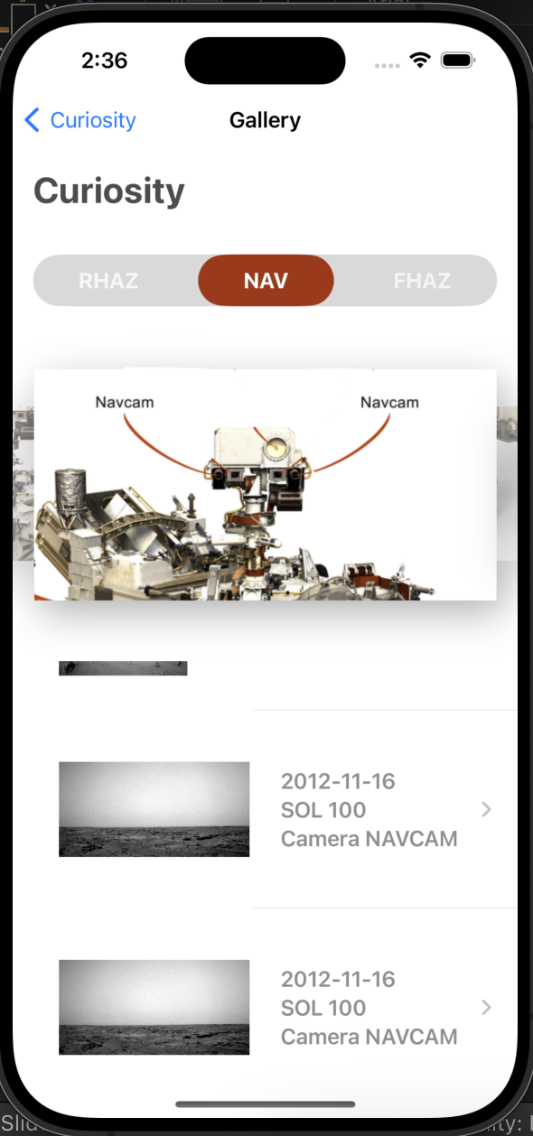
Features – Milestone3
Retrieve data using JSON
Load data from API and display image
Demo

Slide 11
Version Comparison
 | Version 1 | Version 2
Method | Storyboard | SwiftUI
Call API | Yes | Yes
Login | No | Yes
User Interface | List View UIPicker View | Custom image slider with DragGesture Custom tab with onTapGesture SceneKit for 3D model

Slide 12
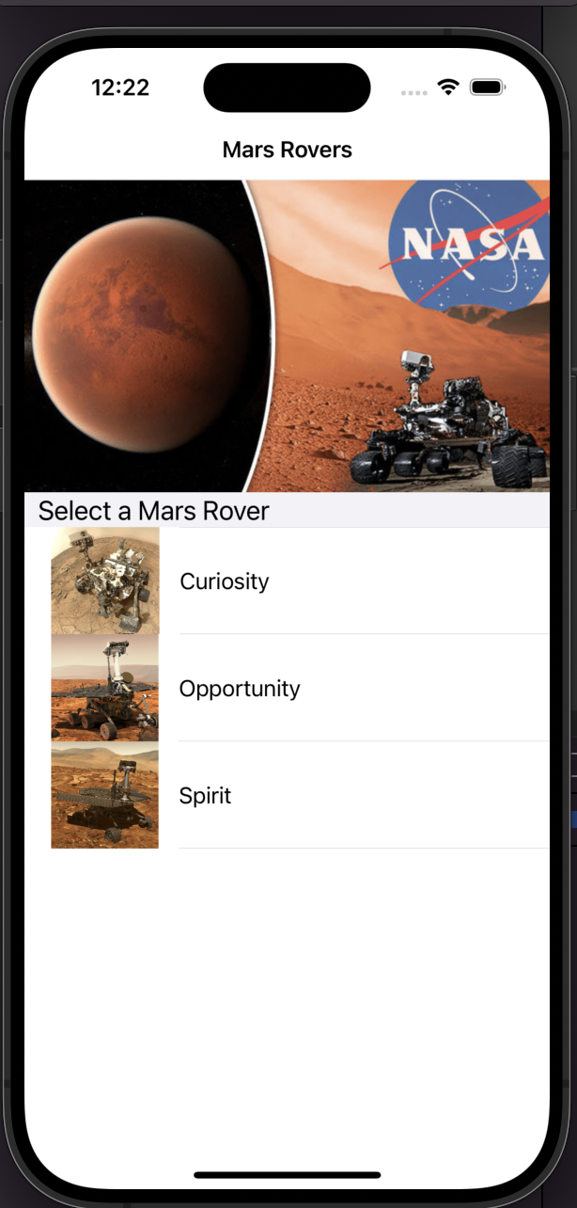
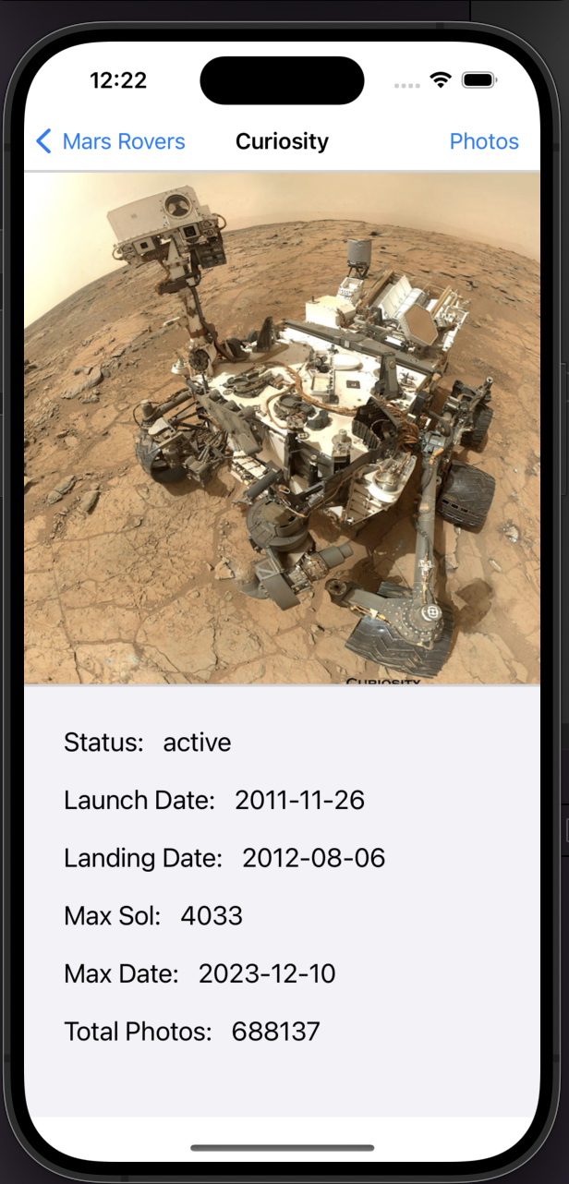
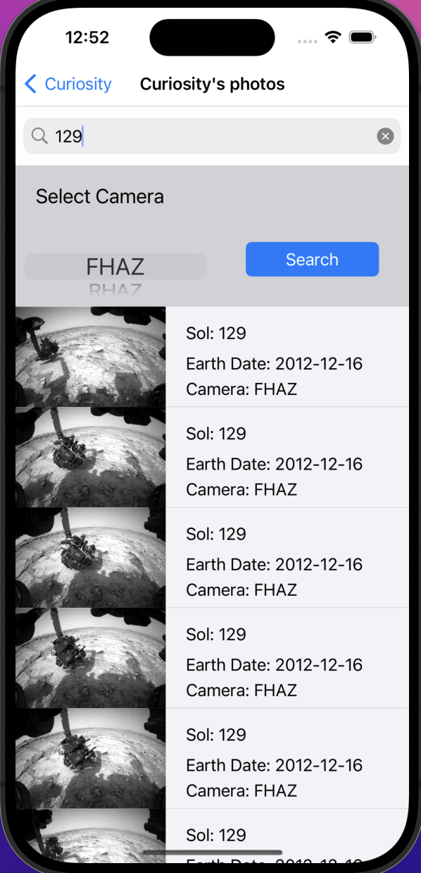
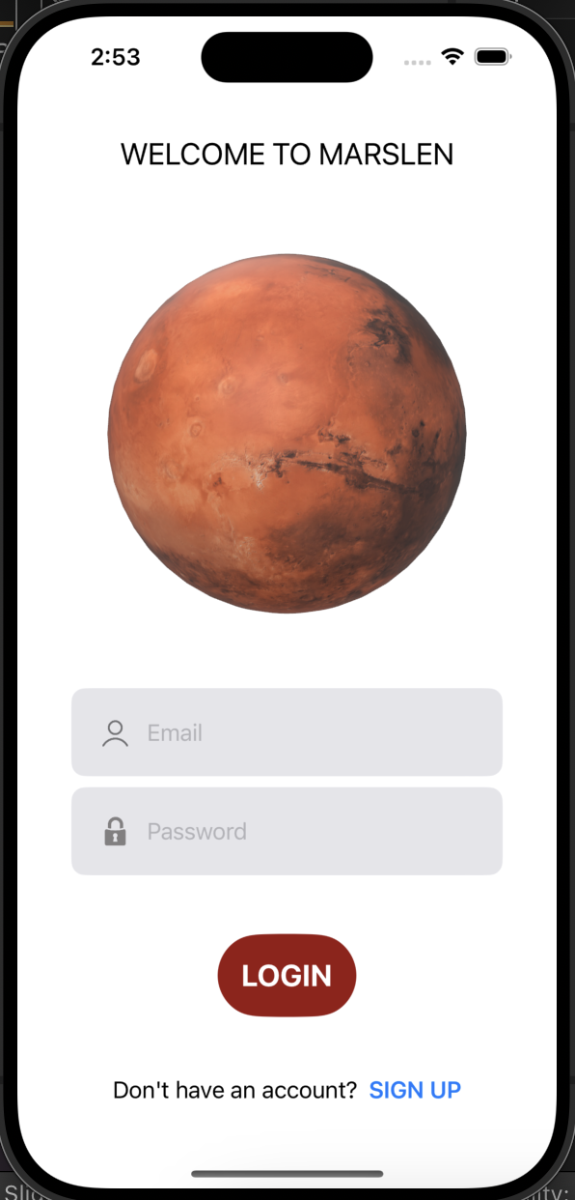
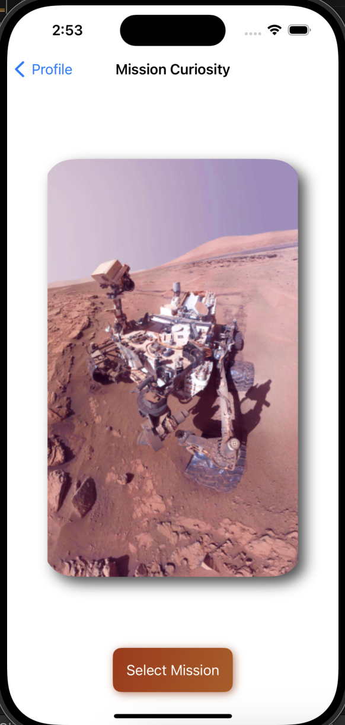
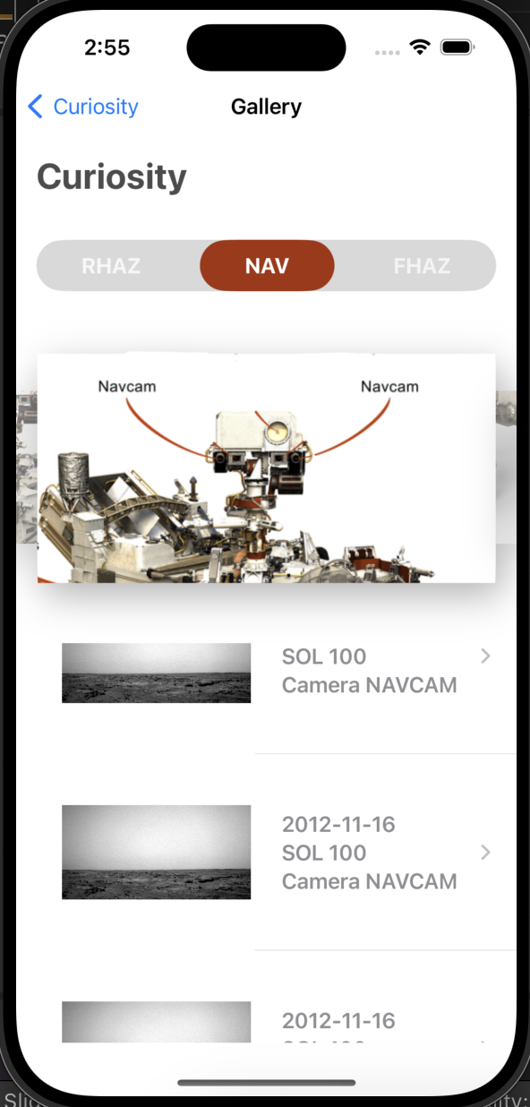
Version Comparison
Version 1:
Version2:

Slide 13

Challenges
NASA API has been updated.
Opportunity and Spirit image cannot load.
Demo

Slide 14

Conclusion
Redesign the app using SwiftUI
Implement sign up, login features using Firebase
Implement upload image
Call API data
Challenges: Fail to load some image due to the change of the API
Upload to App Store

Slide 15
Thank you

